Slide 1
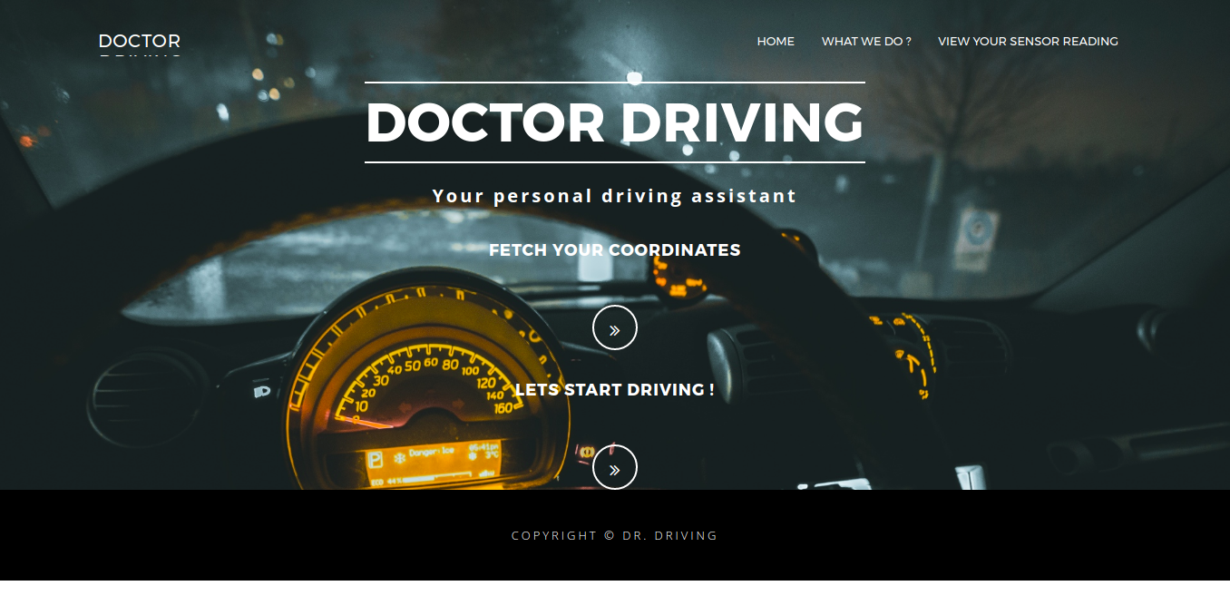
Doctor Driving
Team BBS_041

Slide 2
What is the problem?
According to a report by the Indian Express, there were 17 deaths on the roads every hour in India in 2016. As per the data cited in the report, the country recorded at least 4,80,652 accidents in 2016, leading to 1,50,785 deaths. The number suggests that at least 413 people died everyday in 1,317 road accidents.
We have tried to reduce the number of preventable road accidents through driver face analysis and detection of bad condition of roads.
Incase of an accident, an SOS message will be sent to the cars nearest to the driver and family members of the driver.
The app will send a prompt to the user if the speed limit exceeds the threshold driving limit of the particular road or highway.
Visualizations will be provided to the user on the app in case she wishes to view the statistics or causes behind the road accidents of a particular state. (i.e due to type of vehicles, weather conditions, road conditions, etc)

Slide 3
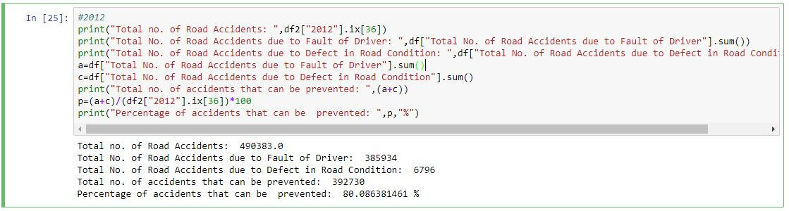
Data Insights
Using the datasets from the Open Government Data Platform India, we have gained the following insights on the causes of road accidents and have devised a model to reduce these numbers:

Slide 4
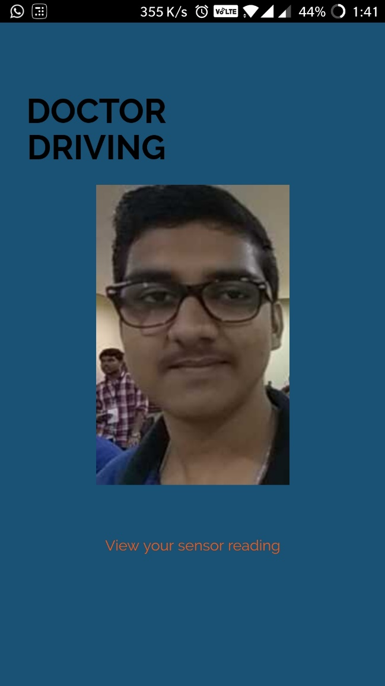
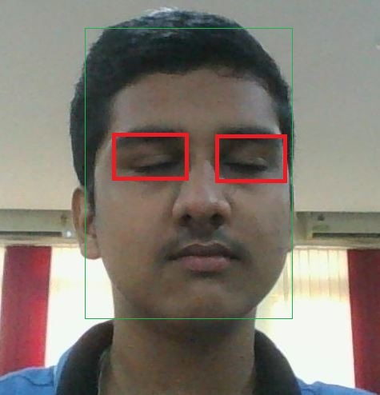
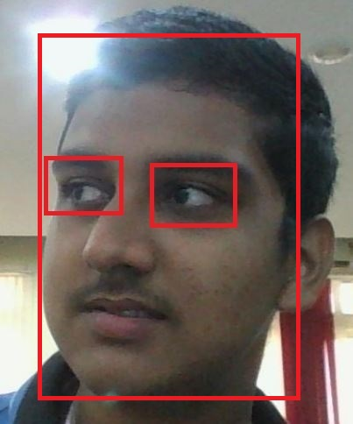
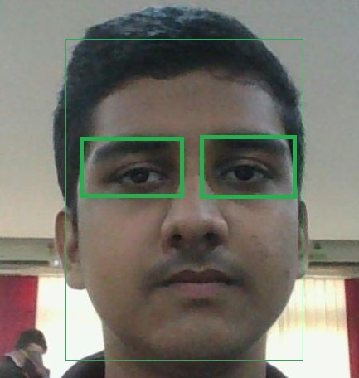
Driver Face Recognition and Analysis
Orientation: Correct
Eye detection: Eyes closed
Orientation: Incorrect
Eye detection: Incorrect
Orientation: Correct
Eye detection: Correct

Slide 5
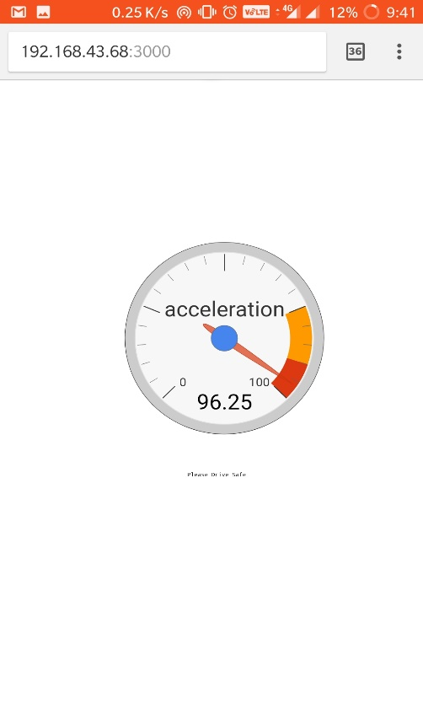
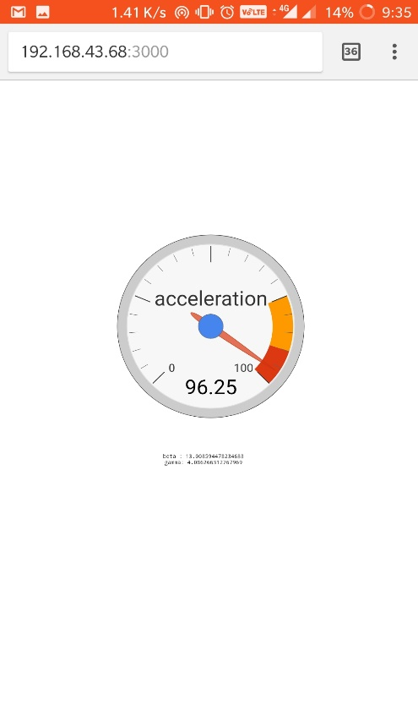
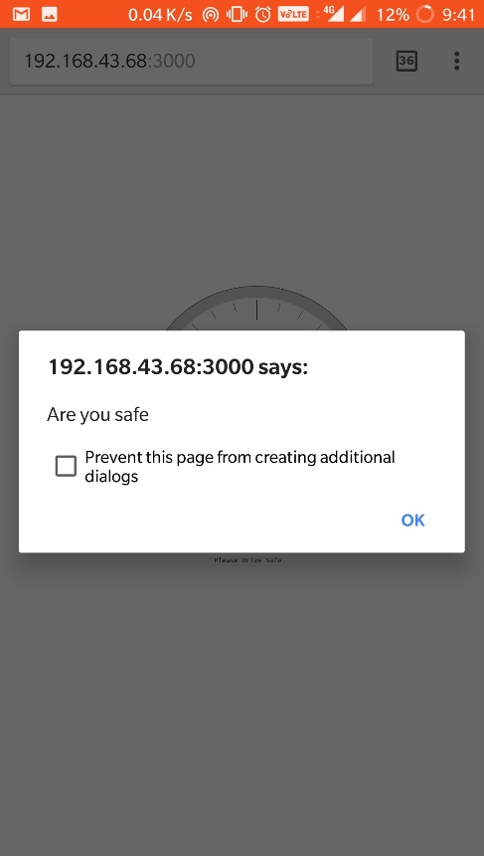
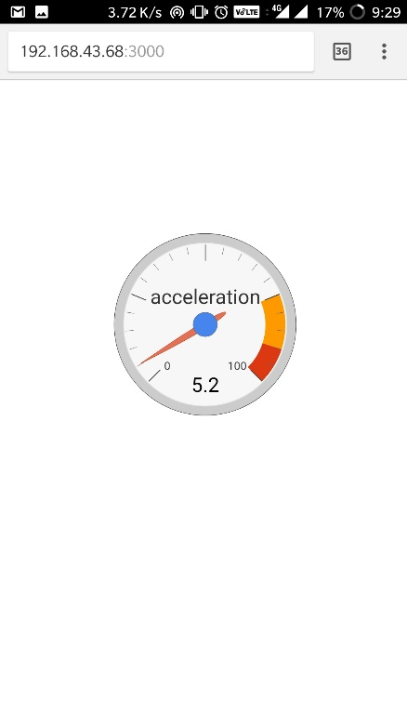

Using mobile sensors
The speedometer module using the accelerometer will keep track of the speed of the car and will send a prompt to the user in case speed limit is exceeded. The “acceptable speed” data will be crowd-sourced.
By use of crowd-sourced data using the gyroscope, bad road conditions will be predicted using alpha beta variations and GPS coordinates.

Slide 6
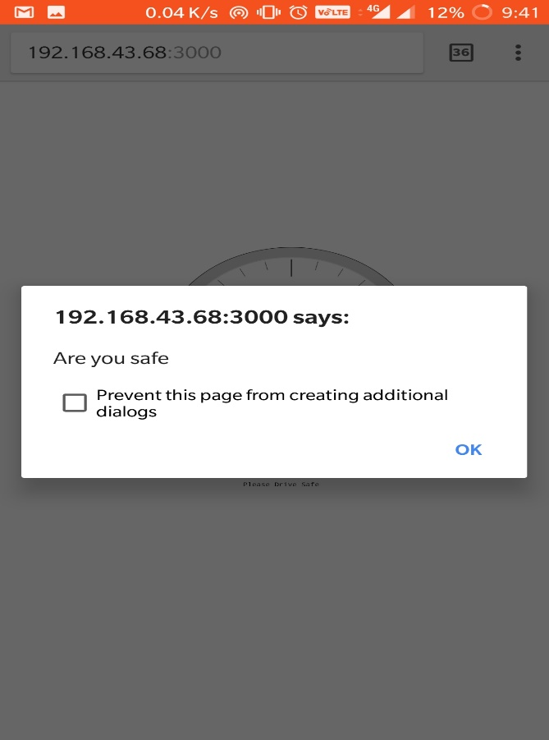
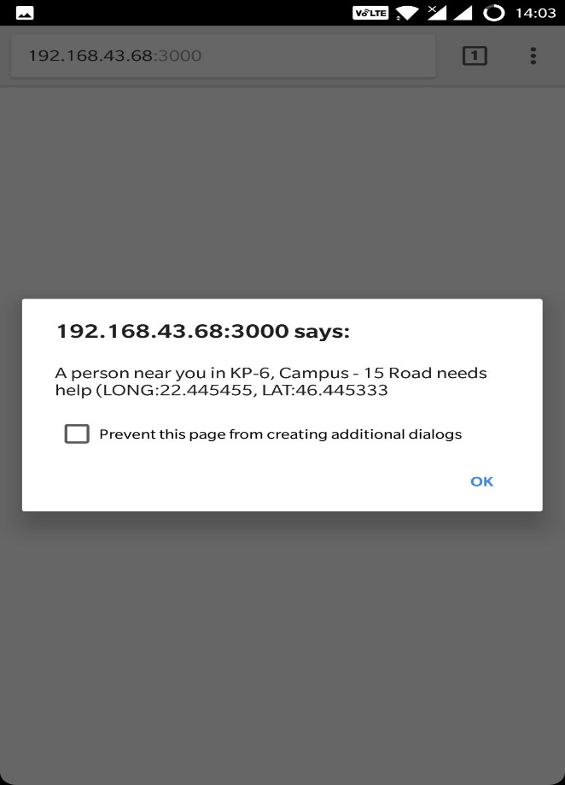
Alert to nearby cars and family members incase of accident
On the occasion of the an accident, not only will a SOS message be sent to the family members, but, the nearby cars will also be alerted after a time out.

Slide 7
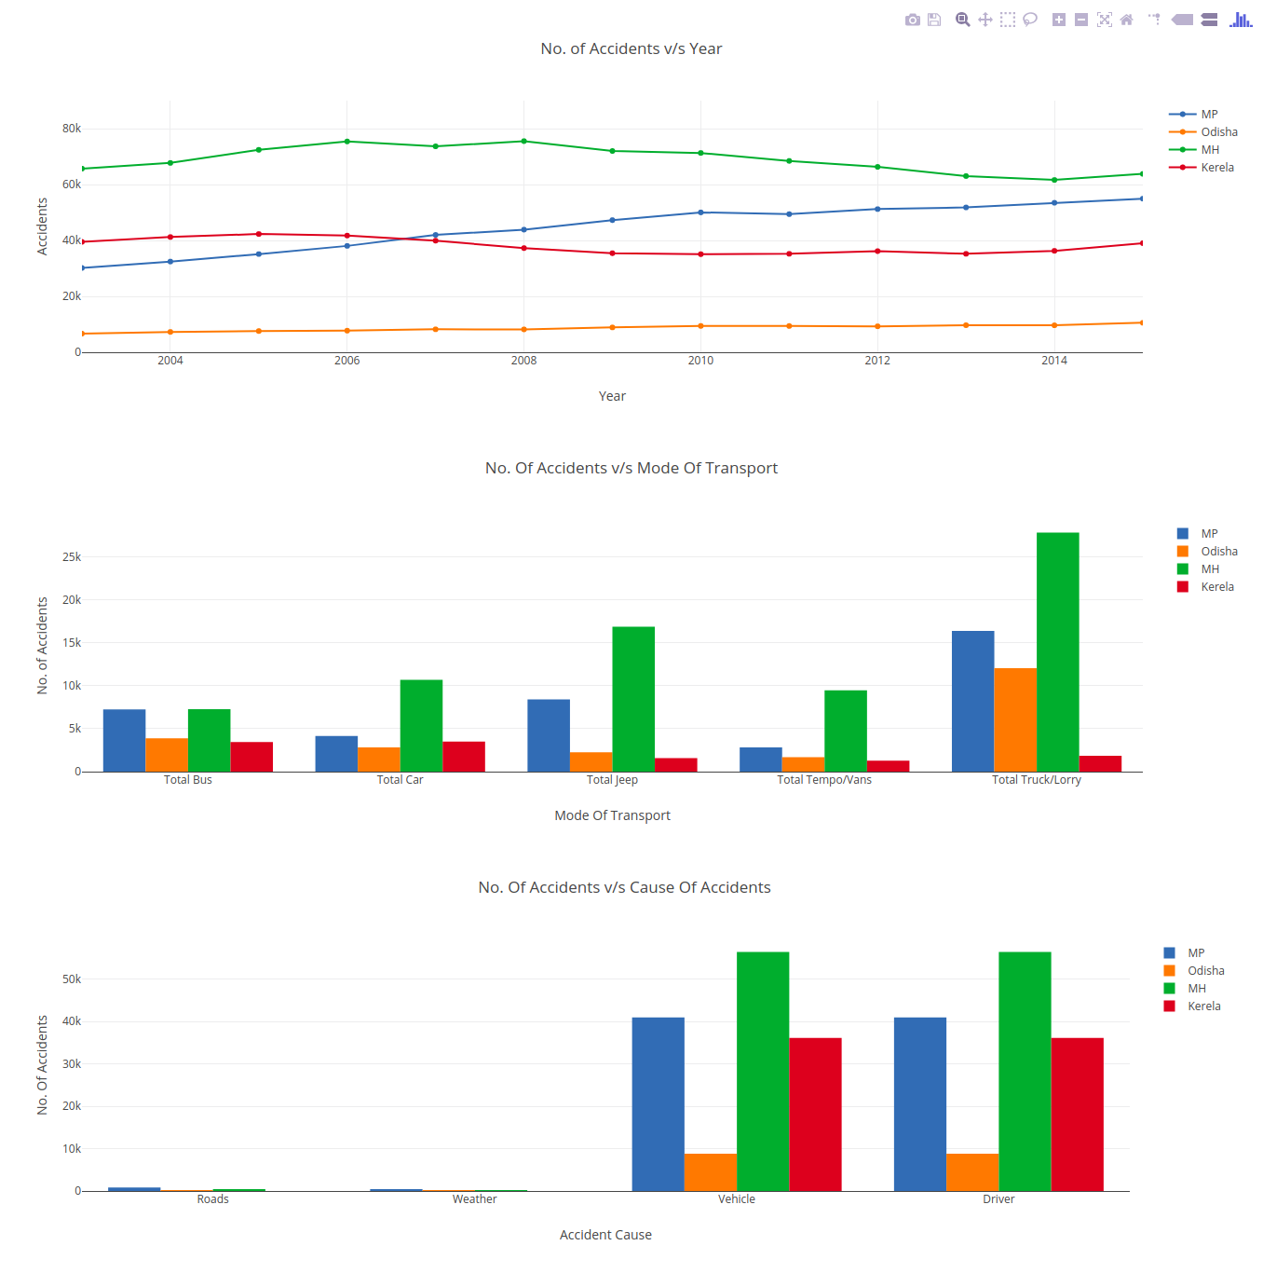
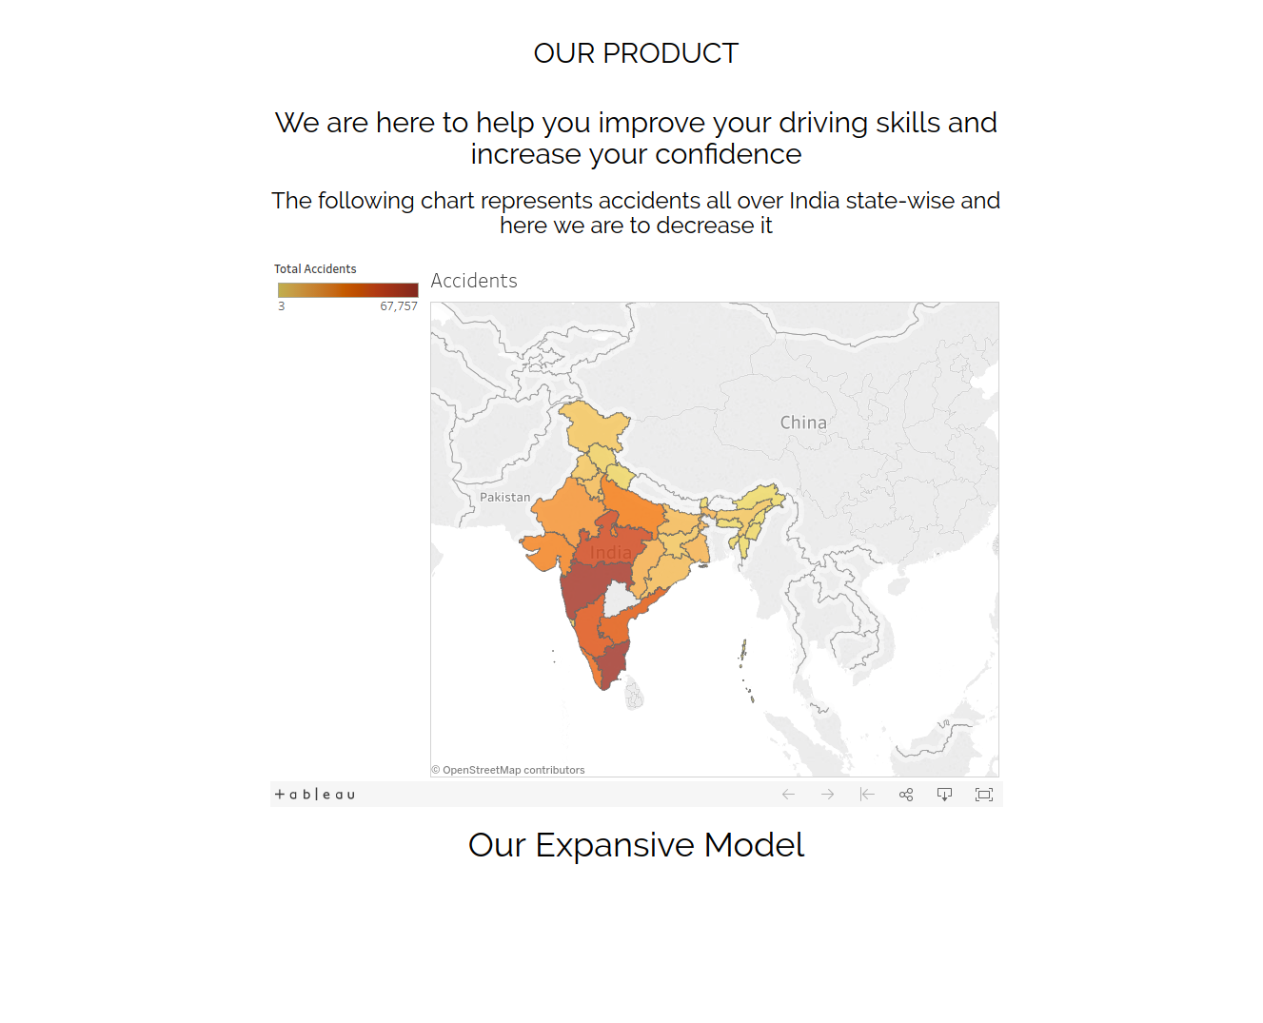
Visualizations available
Visualizations available to the users for making informed decisions (with the use of Open Government Data Platform India datasets) :

